Slide 1
Job recommendation system
By – Pradeep Kumar Chauhan

Slide 2
Introduction
The Job Market Analysis and Recommendation System aims to analyze job market trends and provide personalized job recommendations to job seekers. This project involves data collection, preprocessing, exploratory data analysis, machine learning modeling, and deployment using Dash.

Slide 3
Data Collection and Preprocessing
The dataset includes job-related information such as job titles, descriptions, salaries, locations, and required skills.
Missing values were handled through imputation techniques.
Text data was processed using NLP techniques such as tokenization, TF-IDF, and word embeddings.
Numerical and categorical features were standardized and encoded for modeling.

Slide 4
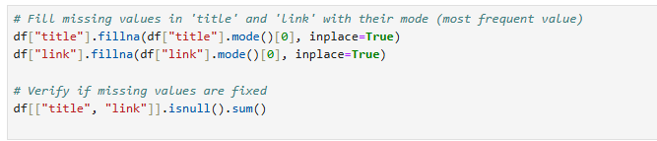
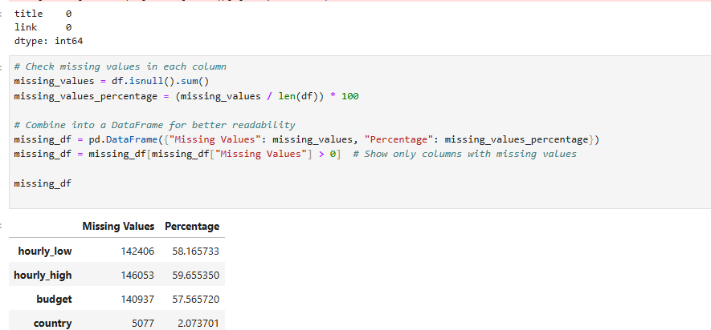
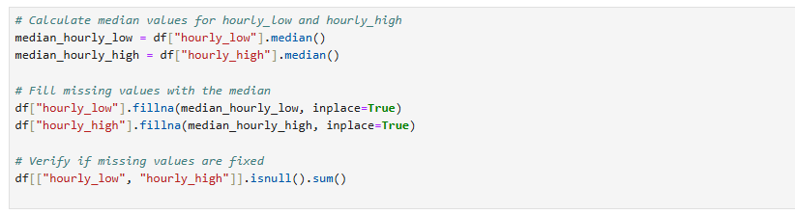

Slide 5
Exploratory Data Analysis (EDA)
Job title vs. salary correlation was analyzed using scatter plots and regression analysis.
High-demand job roles were identified based on frequency counts.
Emerging job categories were detected through clustering techniques.
Hourly rate variations across different regions were visualized.
Remote work trends were examined using time-series analysis

Slide 6
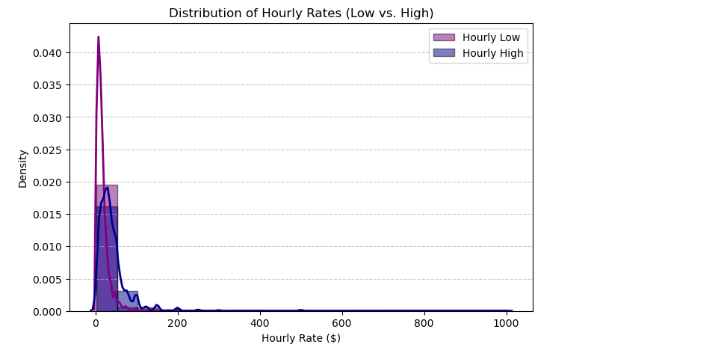
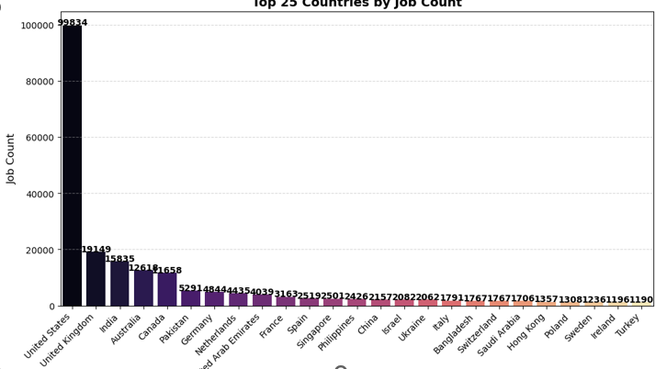

Slide 7
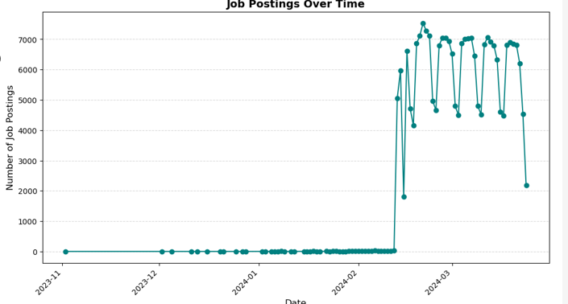

Slide 8
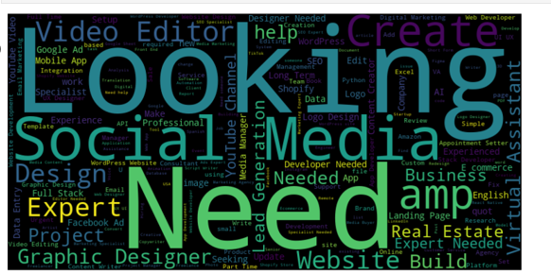

Slide 9
Feature Engineering
Derived new features such as job posting age, required skill clusters, and location-based salary adjustments.
Used feature selection techniques like mutual information and variance thresholding.

Slide 10
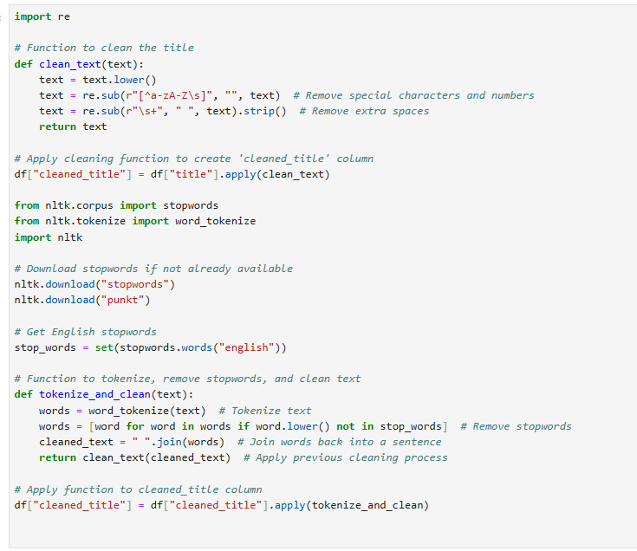

Slide 11
Model Development
Implemented various machine learning models for job recommendation, including:
Content-based filtering using TF-IDF and cosine similarity.
Collaborative filtering using matrix factorization (SVD, ALS).
Hybrid approach combining content-based and collaborative filtering.
Evaluated models using precision, recall, F1-score, and RMSE

Slide 12
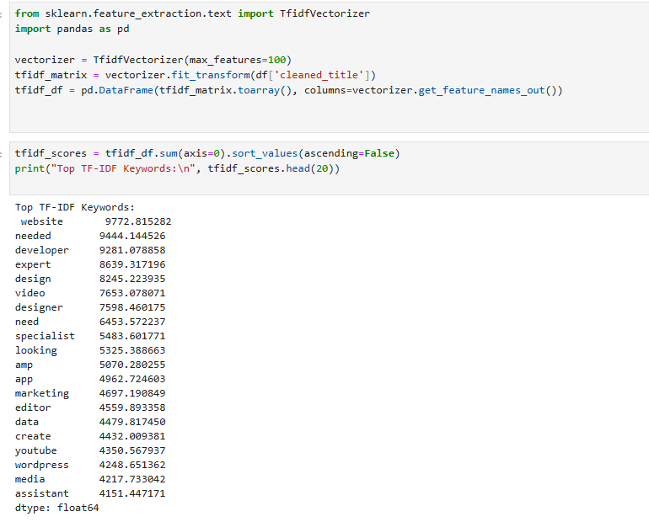

Slide 13
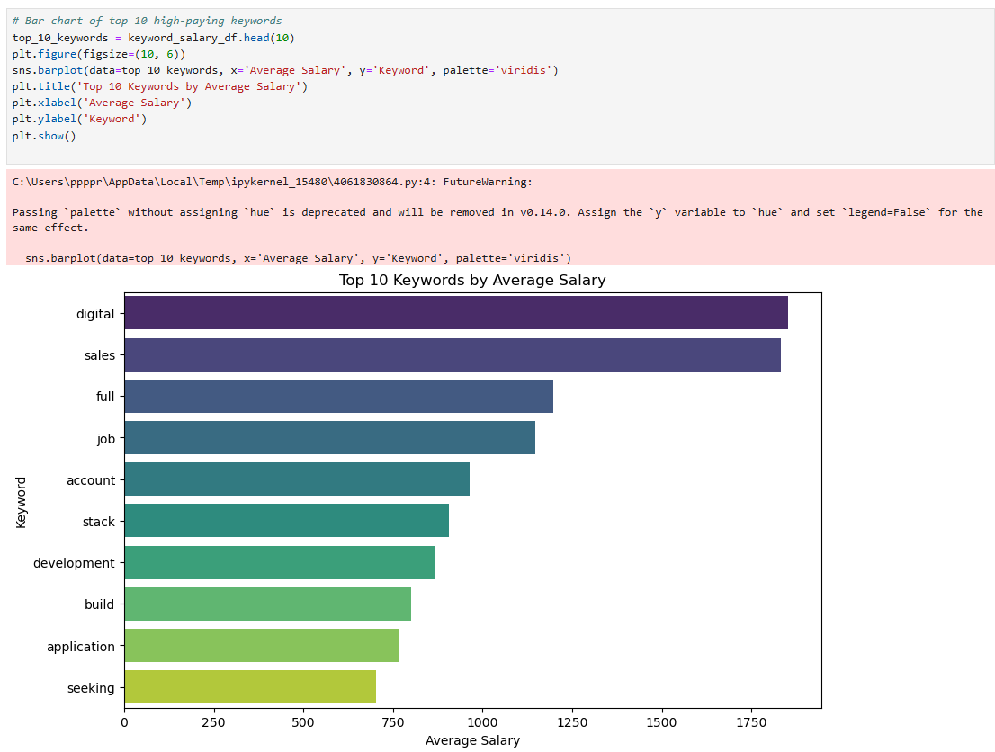

Slide 14
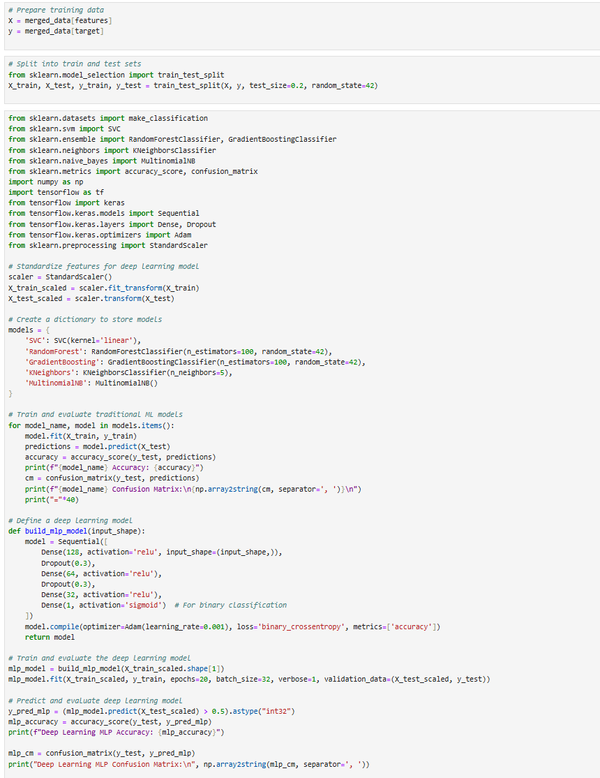
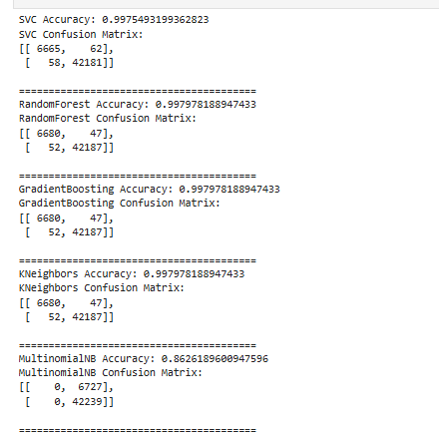


Slide 15
Deployment using Dash
Built an interactive web application using Dash for real-time job recommendations.
Implemented filters for job seekers based on skills, location, and salary range.
Integrated the trained recommendation model into the application backend.

Slide 16
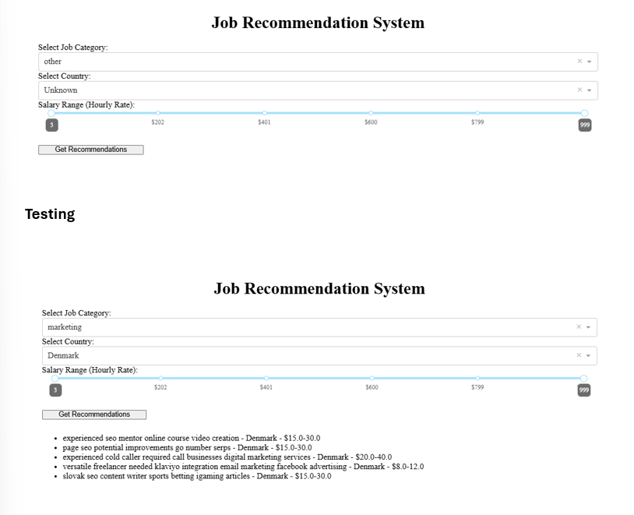

Slide 17
Thank you

